Slide 1
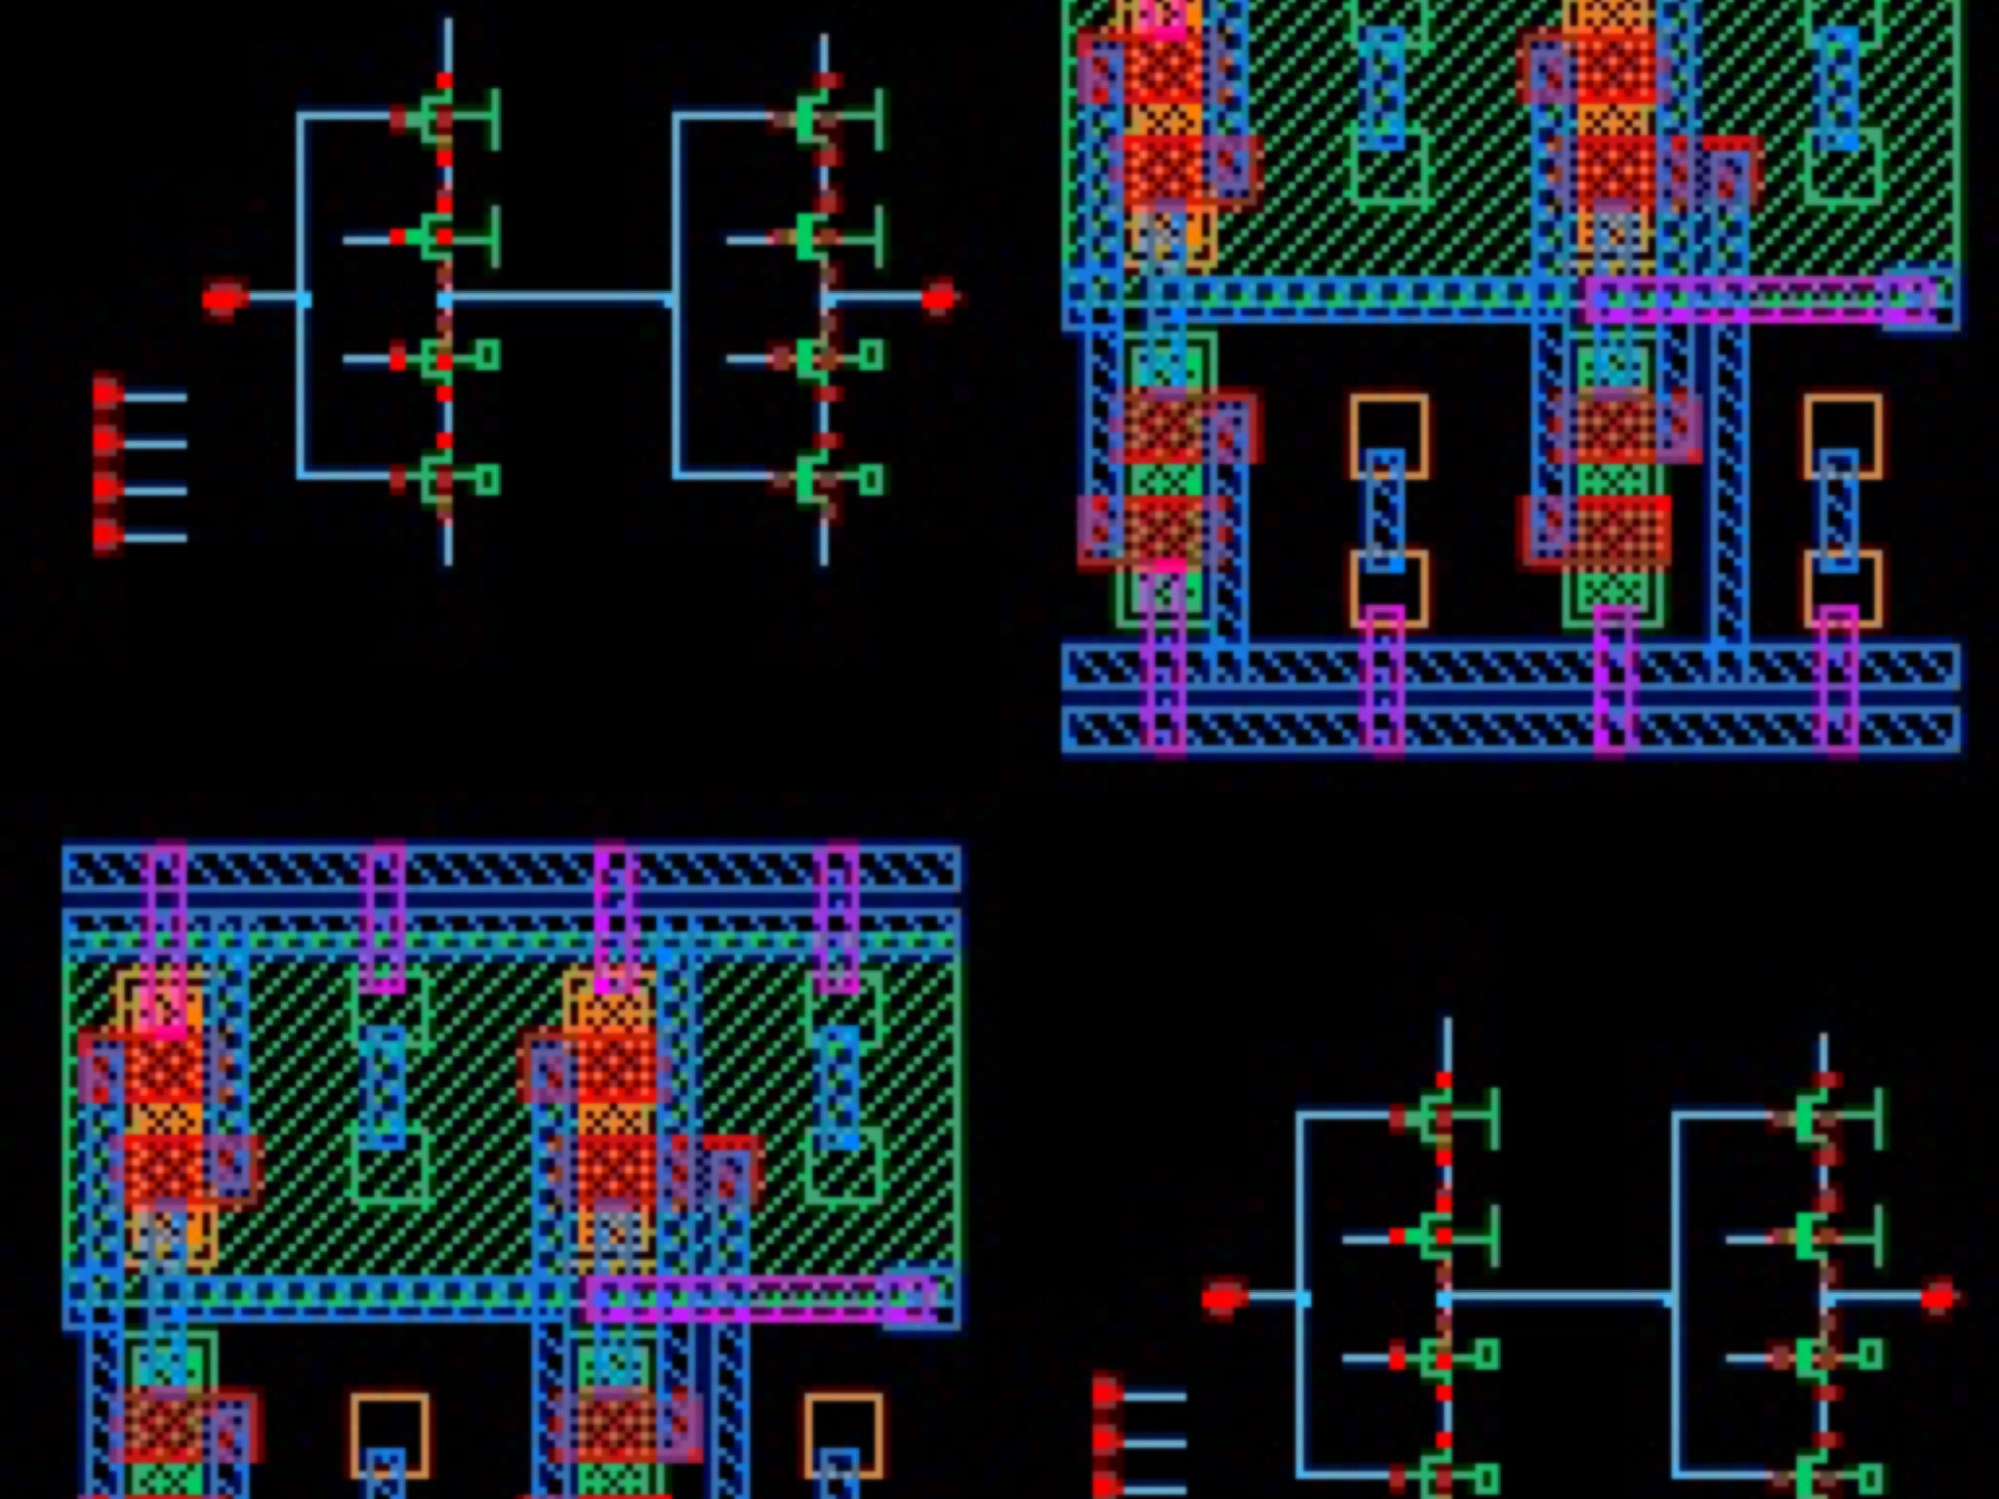
C2MOS Latch – Shift Register
Alexander Shen, Brian Zhou, Hayley Chu

Slide 2
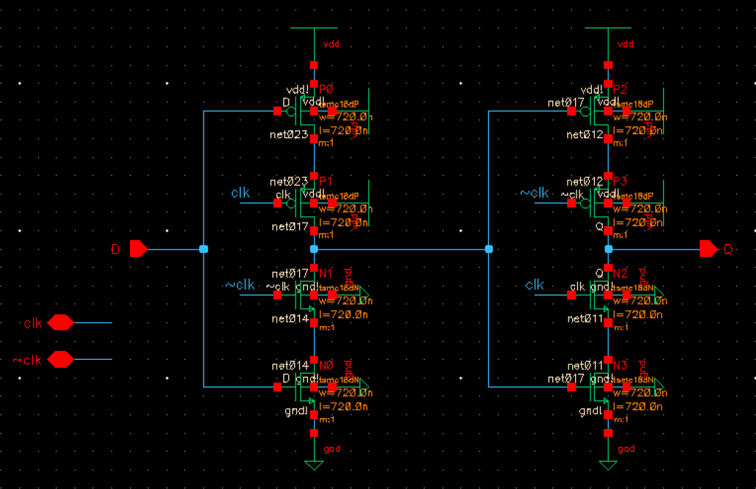
C2MOS Latch Schematic
Alexander Shen, Brian Zhou, Hayley Chu
Johns Hopkins University | Department of Electrical and Computer Engineering | Baltimore, MD
This is the schematic for the C2MOS Latch.
Because they are manufactured on a wafer, all transistors share the same bulk. We learnt that to reduce bulk effect, we have to tie source to bulk. But because all transistors will share the same bulk, we had to avoid this by tying every bulk to ground/ lowest potential. For NMOS its VSS and for PMOS its VDD. Although this introduces bulk effect, in a digital circuit if you introduce a strong enough gate voltage we can mitigate that.
To maintain a clean schematic without wires overlapping, I chose to use pins to define the signals and label the wires on the schematic.
For the layout vs schematic checks to work properly, I moved the inverter for the clock signal and capacitors to my simulation schematic which is shown on the next slide.
Contributions
Alexander Shen

Slide 3
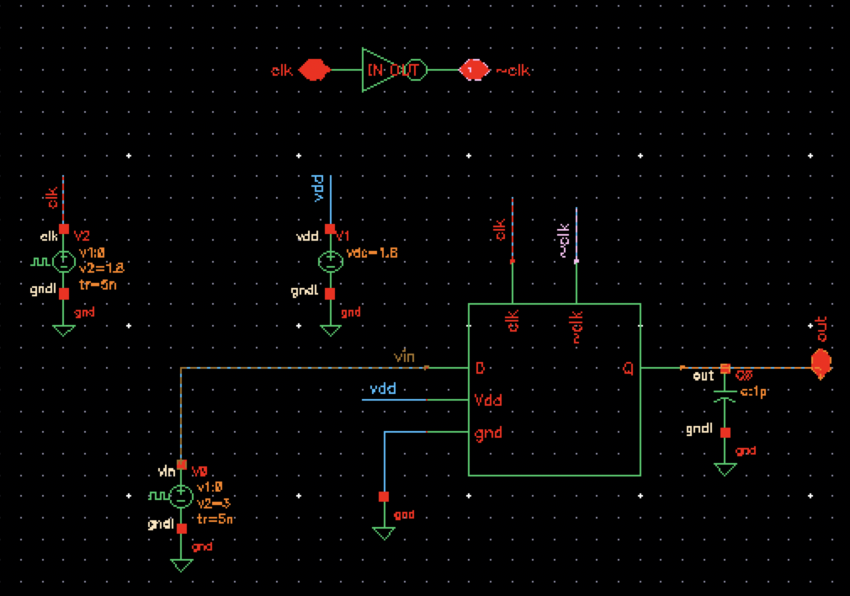
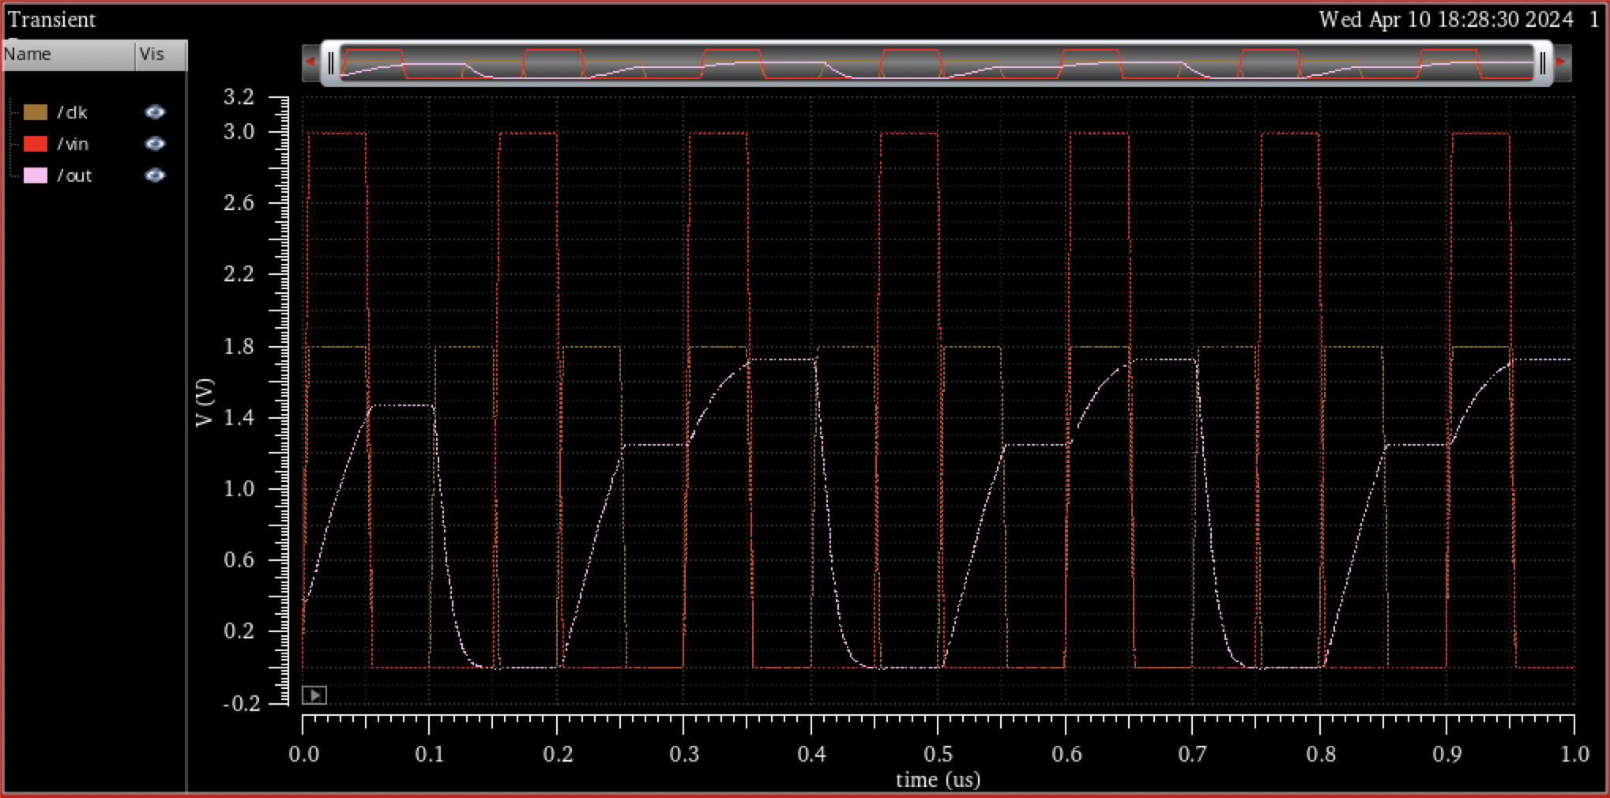
Simulation for one C2MOS Latch
Alexander Shen, Brian Zhou, Hayley Chu
Johns Hopkins University | Department of Electrical and Computer Engineering | Baltimore, MD
This is the simulation schematic and timing diagram for the C2MOS Latch.
To make sure the Layout Versus Schematic is consistent, the capacitor and inverter are both moved into this simulation schematic.
I chose to use a rectangle as the symbol shape because it is basically a D Latch and they usually have a rectangle shape.
The timing diagram shows the clock, vin, and vout voltages. I gave the Clk a period of 100 nanoseconds and the vin signal a period of 150 nanoseconds so that They will only overlap every 300 nanoseconds and show that the latch is working as intended; vout only gets the vin value when Clk is high.
Contributions
Alexander Shen

Slide 4
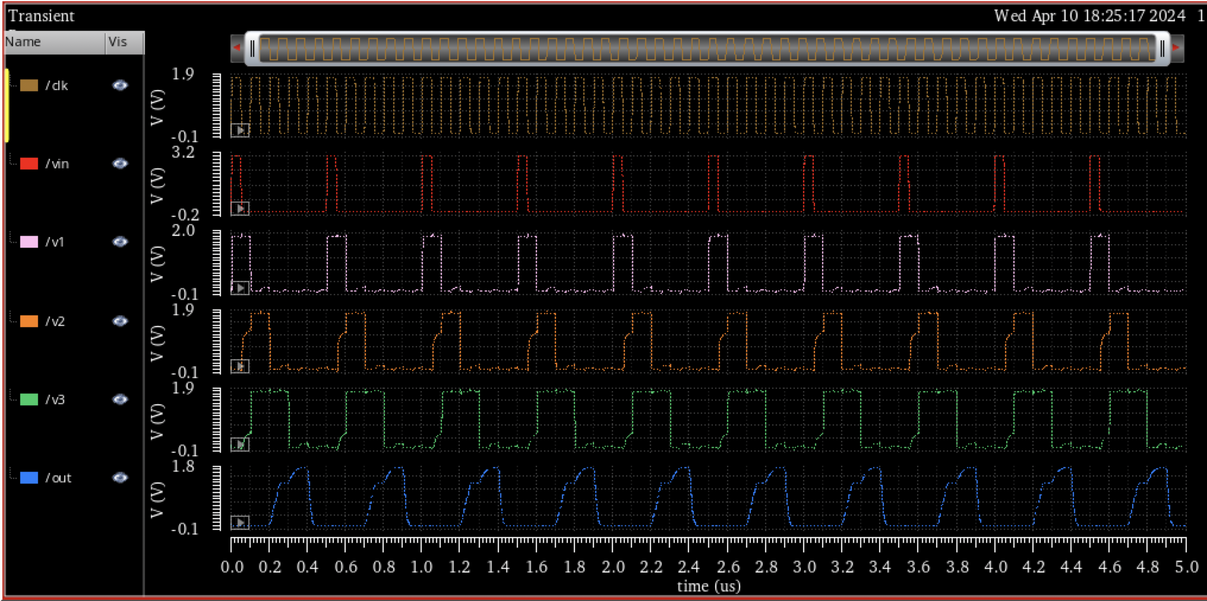
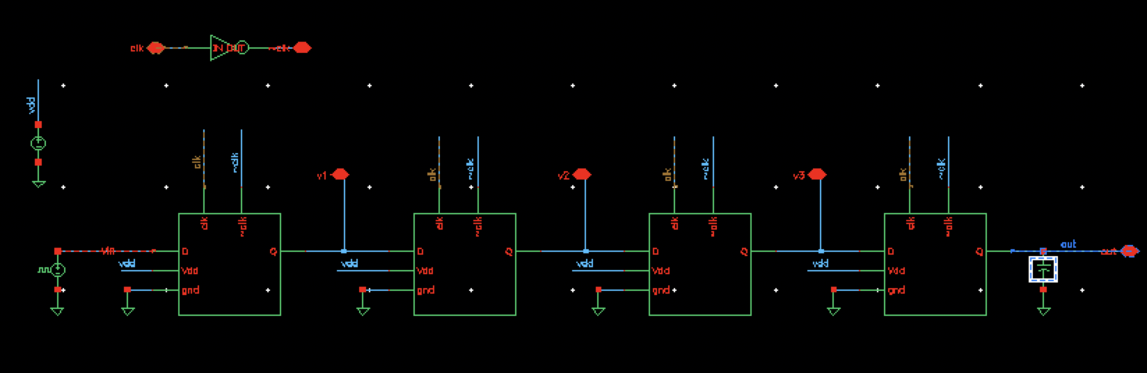
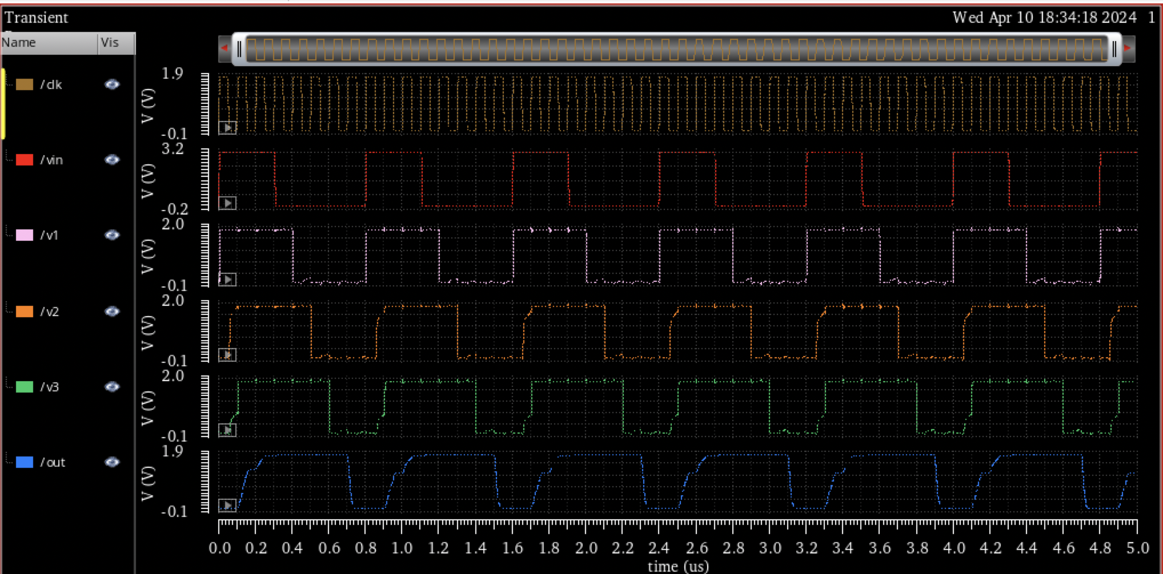
Simulation for Shift Register
Alexander Shen, Brian Zhou, Hayley Chu
Johns Hopkins University | Department of Electrical and Computer Engineering | Baltimore, MD
This is the simulation schematic and timing diagrams for the shift register made from C2MOS Latches.
I tested the vin with a pulse width of 300 nanoseconds and period of 800 nanoseconds as well as pulse width 45 nanoseconds and period 150 nanoseconds (same as latch test earlier).
It demonstrates shift register behavior.
Contributions
Alexander Shen

Slide 5
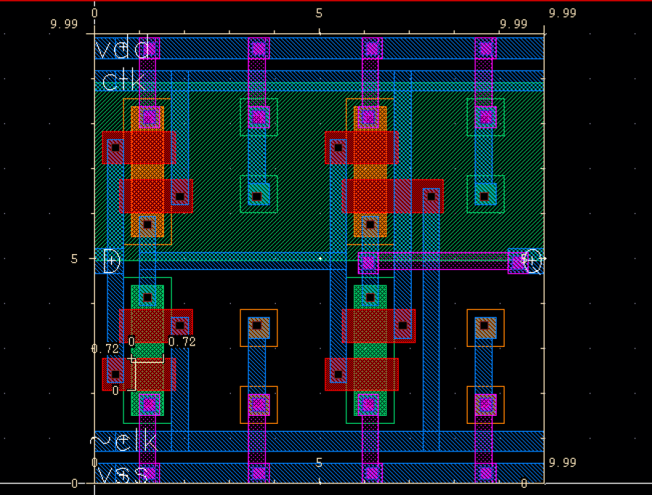
C2MOS latch layout (without capacitors)
Alexander Shen, Brian Zhou, Hayley Chu
Johns Hopkins University | Department of Electrical and Computer Engineering | Baltimore, MD
This is the layout that doesn’t include capacitors.
When I started the layout, I prioritized symmetry and readability in mind. I also stacked the components close together so that there would be sufficient space in case we wanted to add extra components such as the capacitors.
Evenly spaced-out bulk terminals in the empty space are added to ensure that the bulk have uniform voltage.
Contributions
Brian Zhou

Slide 6
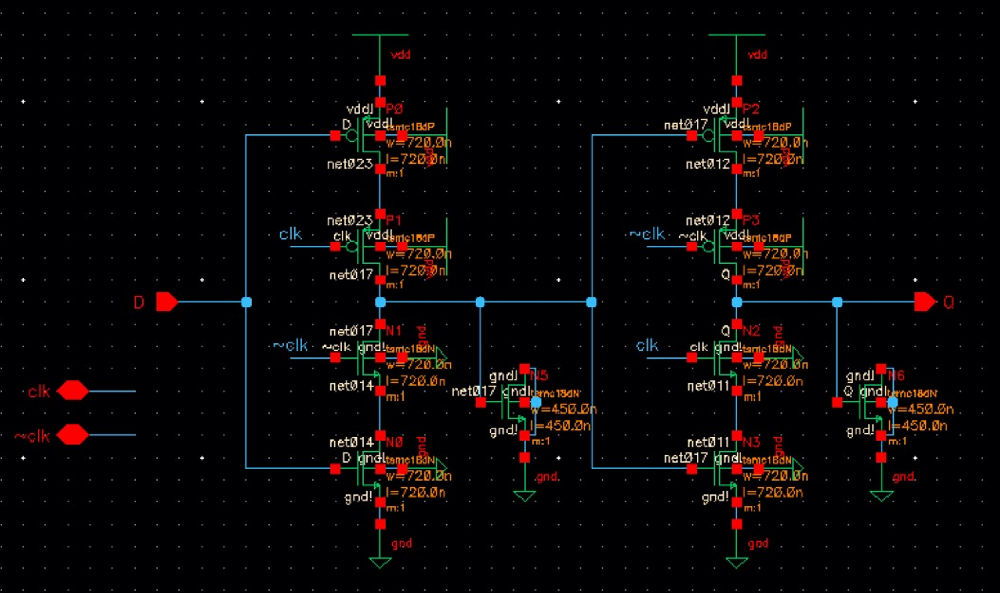
C2MOS Latch Schematic (With capacitor)
Alexander Shen, Brian Zhou, Hayley Chu
Johns Hopkins University | Department of Electrical and Computer Engineering | Baltimore, MD
This is the schematic for the C2MOS Latch, with NMOS as capacitors.
Specifically, we tied the source and drain of the NMOS together and used the gate capacitance as the capacitor.
The dimensions of the NMOS for capacitors was determined based on the space available on the layout (450 nm x 450 nm), but further optimization can be done.
Contributions
Brian Zhou

Slide 7
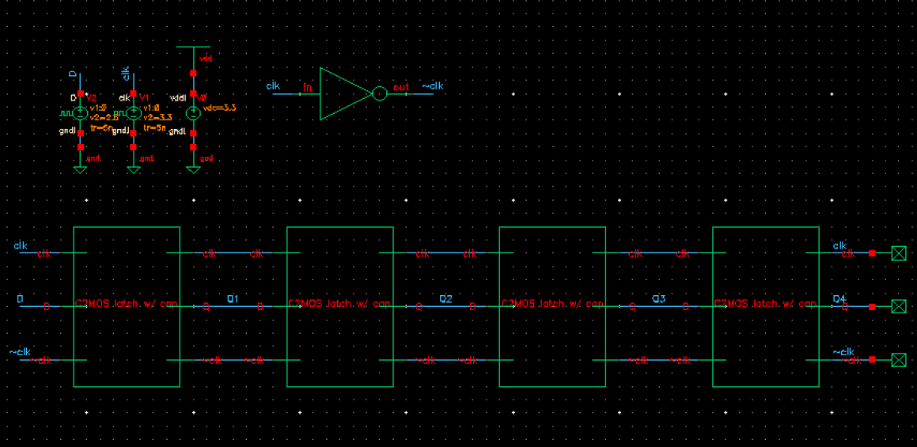
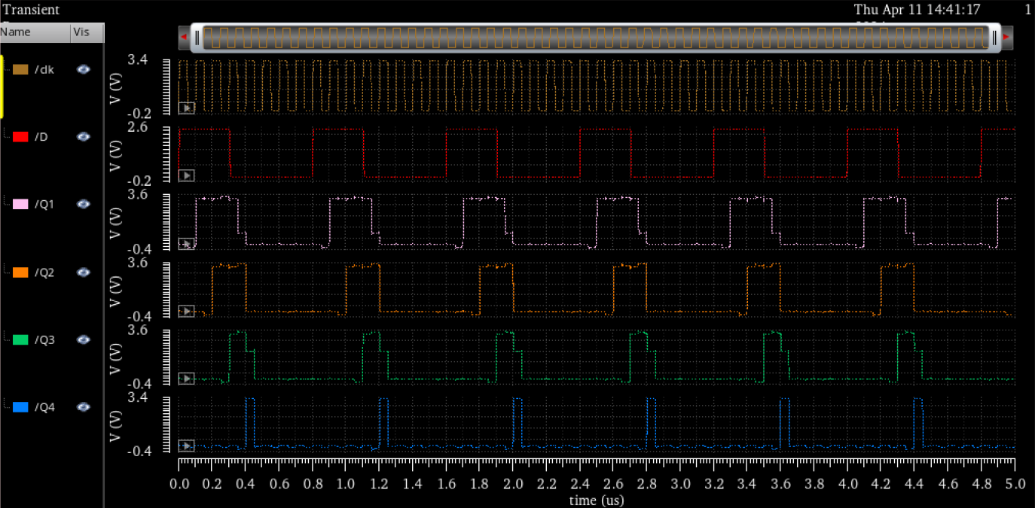
Simulation for Shift Register (latch with capacitors)
Alexander Shen, Brian Zhou, Hayley Chu
Johns Hopkins University | Department of Electrical and Computer Engineering | Baltimore, MD
This is the simulation schematic and timing diagram for the shift register made from C2MOS Latches with capacitors. Test conditions are the same as the previous simulation.
Shift register behavior is observed, but somehow not the whole input signal is passing through all the latches. Upon closer inspection, the unexpected behavior is mostly due to changes happening right at clock edge. We plan to tweak the input signal further to thoroughly test the behavior of the latch.
Contributions
Brian Zhou

Slide 8
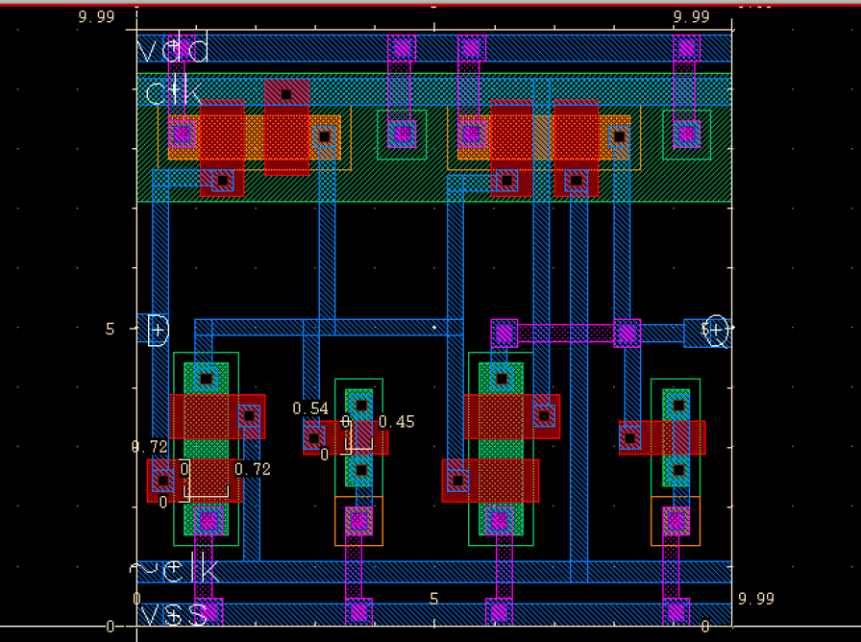
Layout with capacitors
Alexander Shen, Brian Zhou, Hayley Chu
Johns Hopkins University | Department of Electrical and Computer Engineering | Baltimore, MD
This is the layout that includes capacitors.
This version includes NMOS as capacitors: I tied source and drain together, so I was essentially using the gate capacitance as the capacitor. Also considering that reducing the area of the n well may reduce the cost for manufacturing, the PMOS are laid horizontally, and that almost halved the area of the n well.
Now there is sufficient space, so both capacitors are implemented. I can adjust the transistor dimensions to tweak the capacitance, but due to lack of time I didn't do much further optimization.
Contributions
Brian Zhou

Slide 9
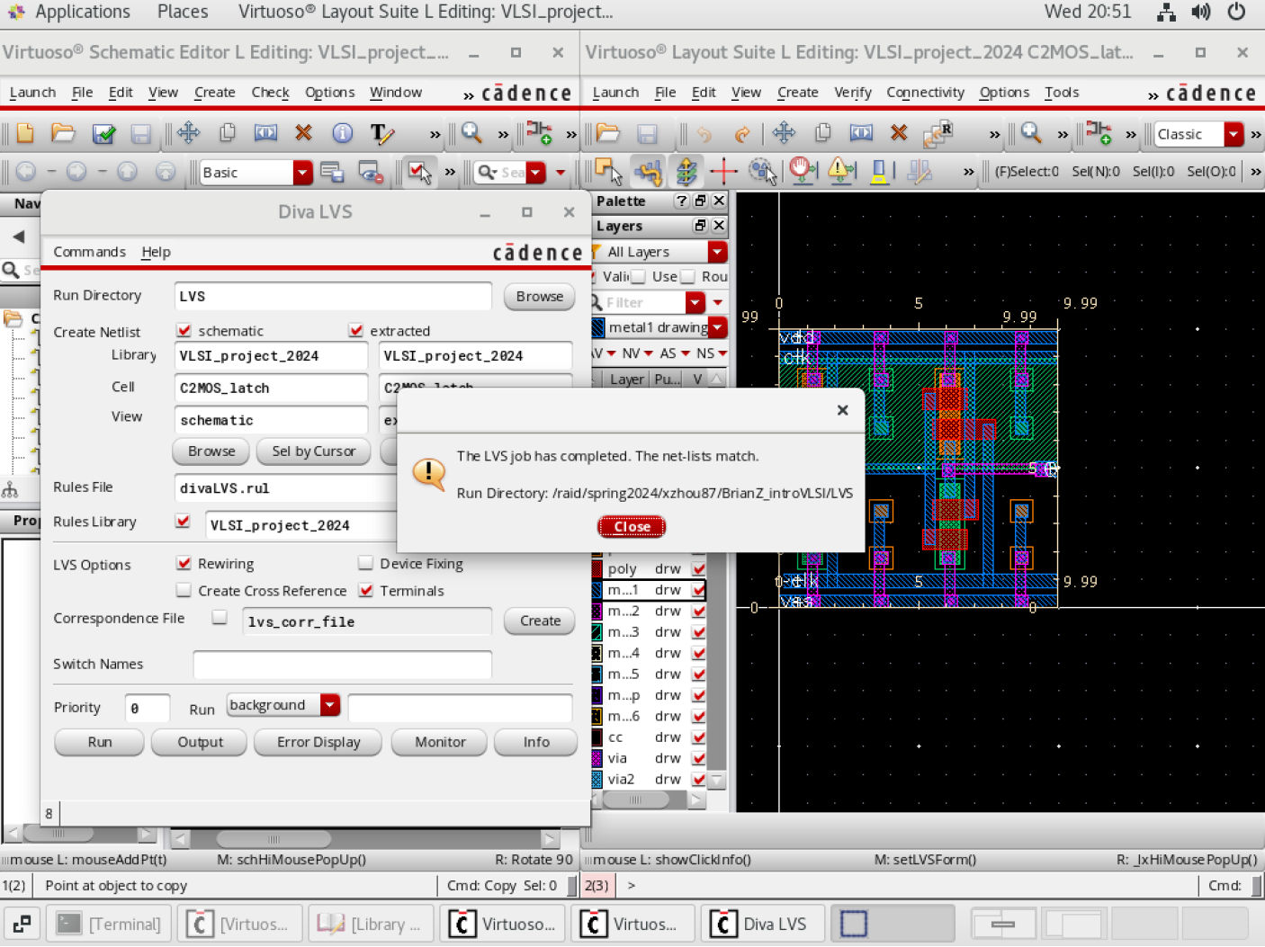
Layout testing
Alexander Shen, Brian Zhou, Hayley Chu
Johns Hopkins University | Department of Electrical and Computer Engineering | Baltimore, MD
Design rule check (DRC):
I mostly only needed to change the dimensions of the instances to make sure the components weren’t overlapping.
I learned that to connect between an active layer to metal layer 2, we need both the cc and via.
Layout-vs-schematic (LVS): I needed to make sure all the terminals have exactly the same name as they are on the layout, and all the nodes are of the same type (input, output, input/output) between the schematic and the layout.
Contributions
Hayley Chu

